Slide 1
ITCS 3134 YinHang Kwok
E19 - Region Segmentation

Slide 2
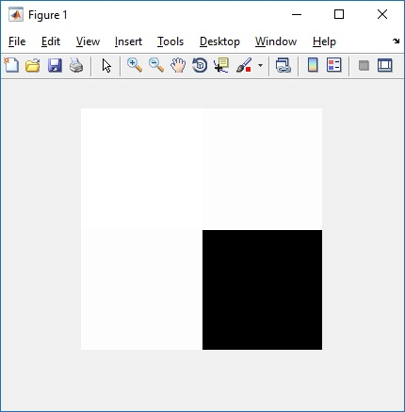
quad.png with T = 100

Slide 3
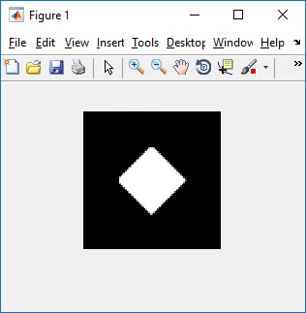
diamond.png with T = 20

Slide 4
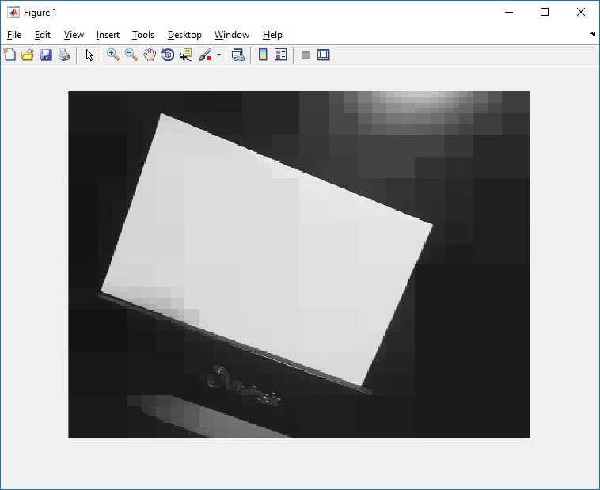
input.png with T = 10

Slide 5
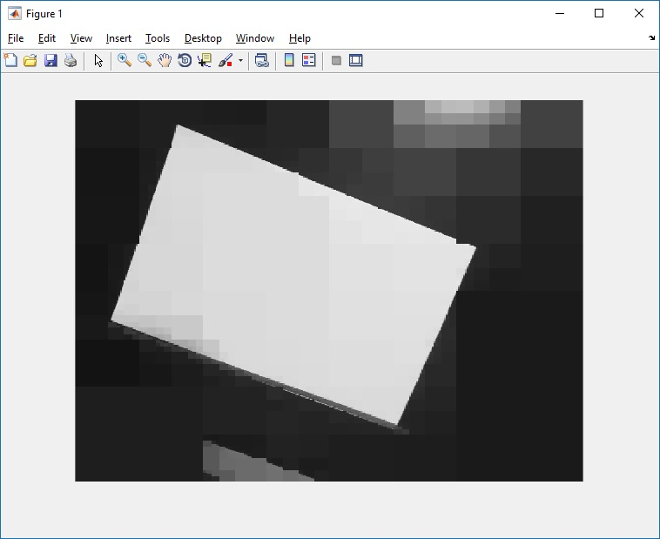
input.png with T = 20

